Slide 1
John 2:13-25
(English Standard Version)
3 Slides

Slide 2
¹³ The Passover of the Jews was at hand, and Jesus went up to Jerusalem. ¹⁴ In the temple he found those who were selling oxen and sheep and pigeons, and the money-changers sitting there. ¹⁵ And making a whip of cords, he drove them all out of the temple, with the sheep and oxen. And he poured out the coins of the money-changers and overturned their tables. ¹⁶ And he told those who sold the pigeons, “Take these things away; do not make my Father’s house a house of trade.” ¹⁷ His disciples remembered that it was written, “Zeal for your house will consume me.”

Slide 3
¹⁸ So the Jews said to him, “What sign do you show us for doing these things?” ¹⁹ Jesus answered them, “Destroy this temple, and in three days I will raise it up.” ²⁰ The Jews then said, “It has taken forty-six years to build this temple, and will you raise it up in three days?” ²¹ But he was speaking about the temple of his body. ²² When therefore he was raised from the dead, his disciples remembered that he had said this, and they believed the Scripture and the word that Jesus had spoken.

Slide 4
²³ Now when he was in Jerusalem at the Passover Feast, many believed in his name when they saw the signs that he was doing. ²⁴ But Jesus on his part did not entrust himself to them, because he knew all people ²⁵ and needed no one to bear witness about man, for he himself knew what was in man.

Slide 5
The Righteous Anger of God.
Mostly kept in check until the Day of Judgment
He sometimes gives us a little glimpse of it now
¹⁴ In the temple he found those who were selling oxen and sheep and pigeons, and the money-changers sitting there. ¹⁵ And making a whip of cords, he drove them all out of the temple, with the sheep and oxen. And he poured out the coins of the money-changers and overturned their tables. ¹⁶ And he told those who sold the pigeons, “Take these things away; do not make my Father’s house a house of trade.”
The Temple of God – The Holy Place Where God Dwells
For worship & prayer
A house of prayer had become a noisy, distracting market place.
The people were being cheated for profit.
“The Sign” is “The Resurrection”
hiero: The whole Temple Complex (particularly the outer courts)
oikon (oikos): “house” “My Father’s House”
naon (naos): The Sanctuary – the holy part of the Temple where God dwells

Slide 6
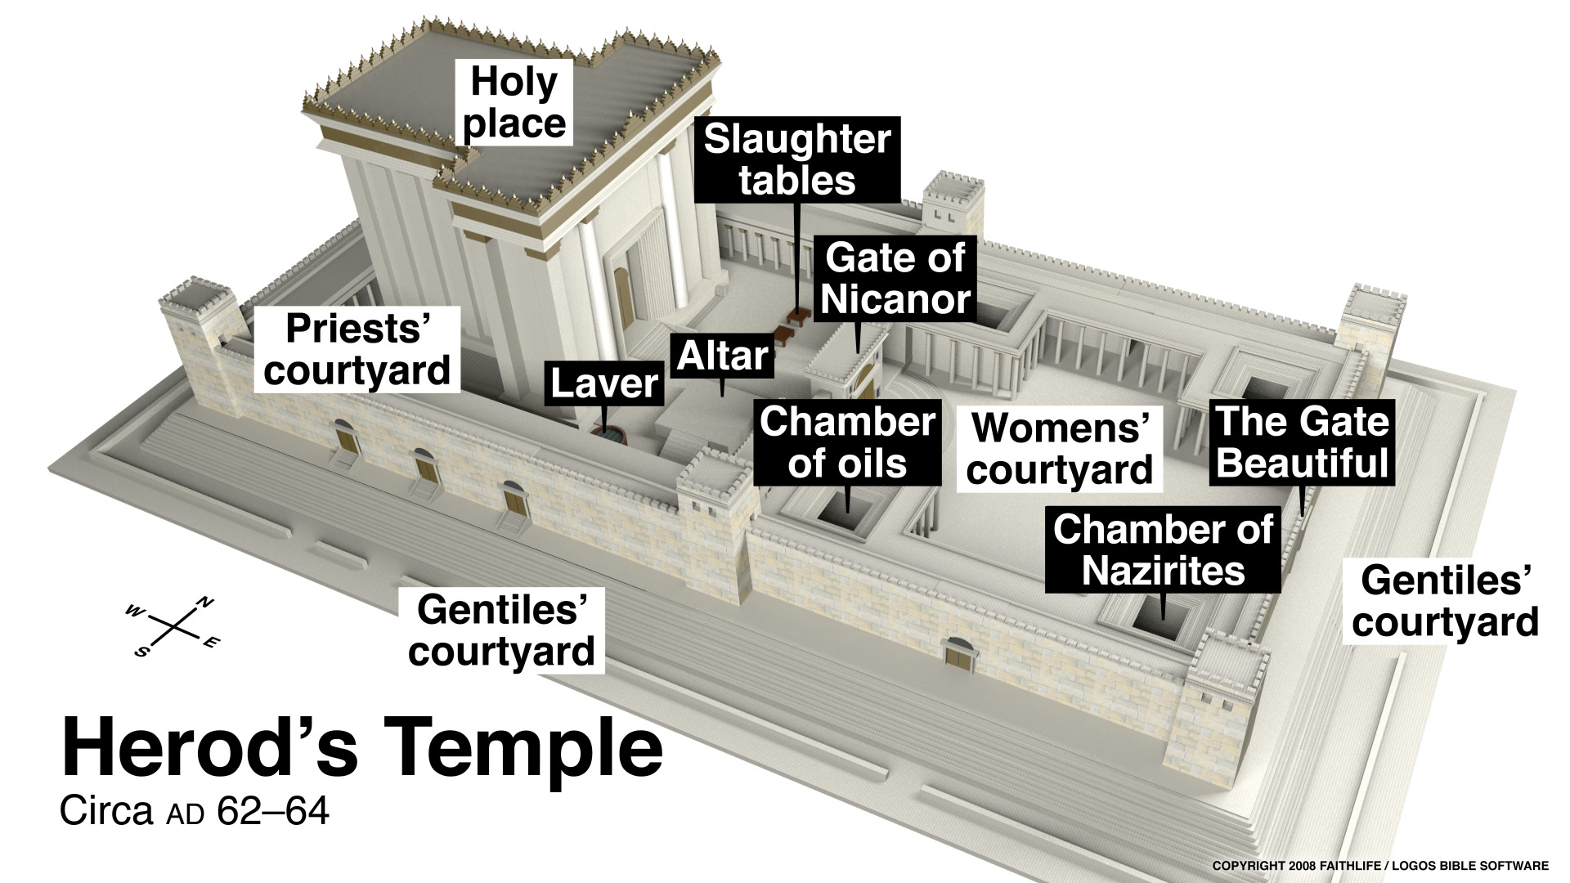
hiero: The whole Temple Complex (particularly the outer courts)
oikon (oikos): “house” “My Father’s House”
naon (naos): The Sanctuary – the holy part of the Temple where God dwells

Slide 7
Isaiah 56:6–8 (ESV)
⁶ “And the foreigners who join themselves to the Lord,
to minister to him, to love the name of the Lord,
and to be his servants,
everyone who keeps the Sabbath and does not profane it,
and holds fast my covenant—
⁷ these I will bring to my holy mountain,
and make them joyful in my house of prayer;
their burnt offerings and their sacrifices will be accepted on my altar;
for my house shall be called a house of prayer for all peoples.”
⁸ The Lord God, who gathers the outcasts of Israel, declares,
“I will gather yet others to him besides those already gathered.”

Slide 8
The Righteous Anger of God.
The Temple of God – The Holy Place Where God Dwells
For worship & prayer
A house of prayer had become a noisy, distracting marketplace.
The people were being cheated for profit.
hiero: The whole Temple Complex (particularly the outer courts)
oikon (oikos): “house” “My Father’s House”
naon (naos): The Sanctuary – the holy part of the Temple where God dwells
A house of prayer for all nations. The whole complex was the house of God.
But the only place foreigners could pray, was over-run by dishonest commerce
“Destroy this [inner place of holiness where God dwells], and in three days I will raise it up.”
1. Jesus is the new naon – the holy place where God dwells
2. The resurrection of Jesus IS the SIGN
2nd person, plural (you lot will destroy).
I will raise up.
There is something deficient in “believing” because of a miraculous sign.
Believe that Jesus is raised from the dead; Yield to Him as Lord; Confess & be forgiven.
The Dwelling Place of God today. “Your body is a naos of the Holy Spirit”
His Holy Spirit now dwells in us because He has made us Holy.

